Slide 1
Real-time Static Gesture Detection Using Machine Learning
From: Sandipgiri Goswami
Supervisor : Dr. Kalpdrum Passi

Slide 2
Contents
About American Sign Language (ASL)
Objectives
Dataset
Hardware & Software used
Image Processing
Machine Learning approach
Results
Future work

Slide 3
About Language:
The method of human communication, either spoken or written, consisting of use of words in structured and conventional way.
There are roughly 6,500 spoken languages in the world today.
English as a global language.
With more than 350 million people around the world speaking English as a first language and more than 430 million speaking it as a second language.

Slide 4
About Sign Language
Convey a message by hand movements, facial expression and body language to communicate.
It is mainly used by deaf and dumb but with hearing capability.
Sometimes family members and relatives must learn sign language to interpret for the dumb and for the wider communities to communicate with each other.
In fact, there are somewhere between 138 and 300 different types of sign languages used throughout the world today

Slide 5
Different Sign Languages in the Americas
North America | Central America | South America
•American Sign Language •Inuit Sign Language •Quebec Sign Language •Puerto Rican Sign Language | •Costa Rican Sign Language •Guatemalan Sign Language •Honduras Sign Language •Mayan Sign Language •Mexican Sign Language •Nicaraguan Sign Language •Panamanian Sign Language •Salvadorian Sign Language •Tijuana Sign Language | •Argentine Sign Language •Bolivian Sign Language •Brazilian Sign Language •Chilean Sign Language •Colombian Sign Language •Ecaudorian Sign Language •Paraguayan Sign Language •Peruvian Sign Language •Uruaguayan Sign Language •Venezuelan Sign Language

Slide 6
Misunderstandings about Sign Language
Similar to spoken language.
Unique language all over the world.
Easy to learn.
Easy to communicate.

Slide 7
About American Sign Language(ASL)
Implemented from French sign language.
Introduced by Thomas Hopins in the United States.
ASL is similar to French sign language.
A variation of American Sign Language also exits.

Slide 8
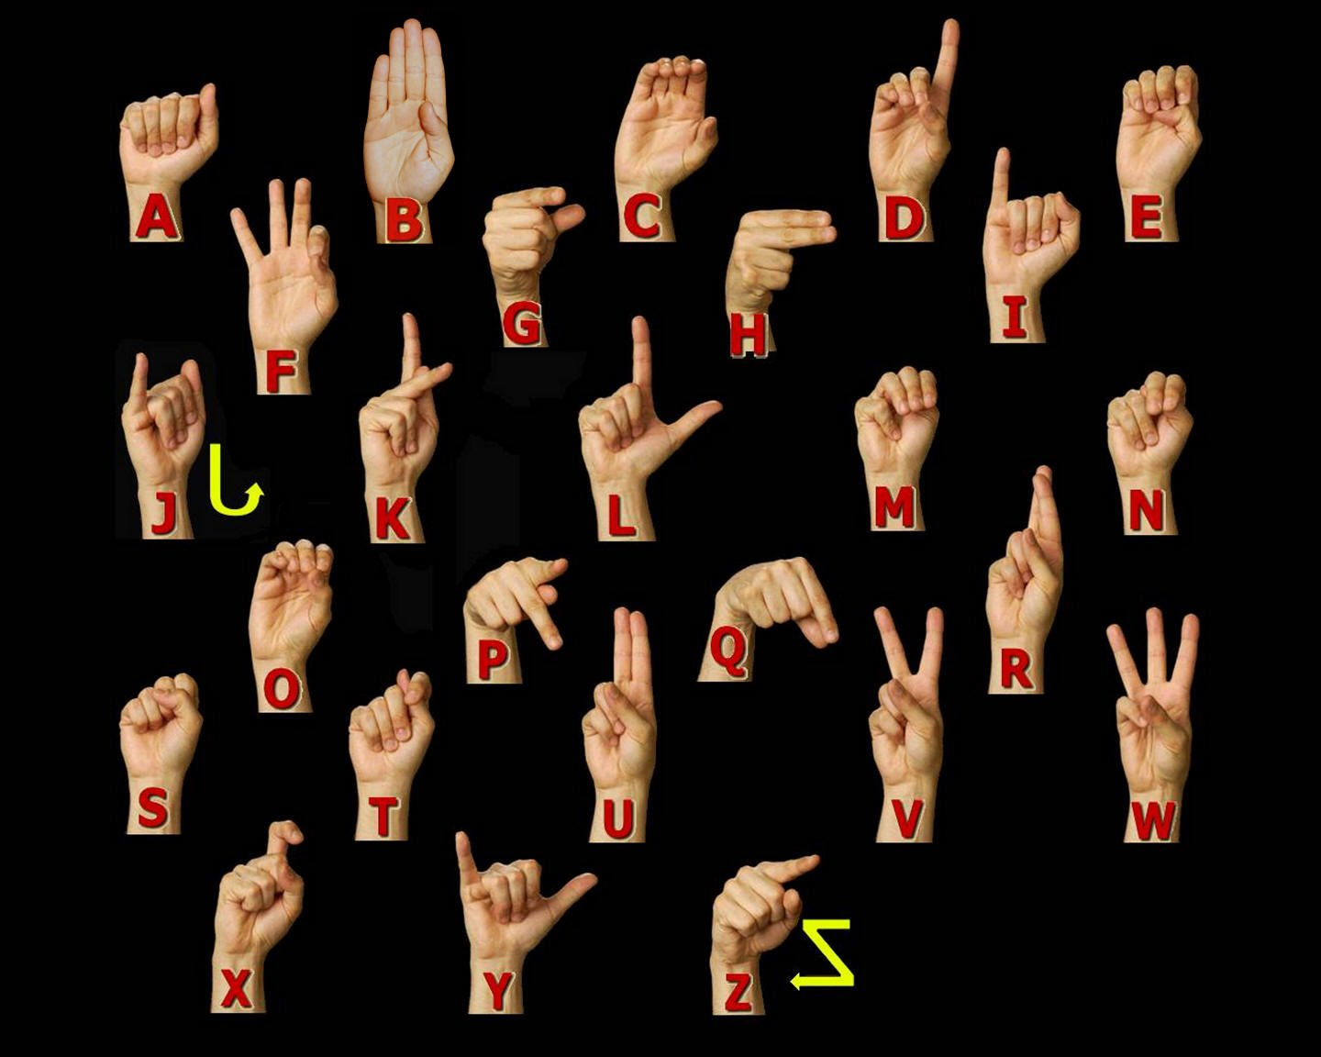
ASL Manual Alphabet

Slide 9
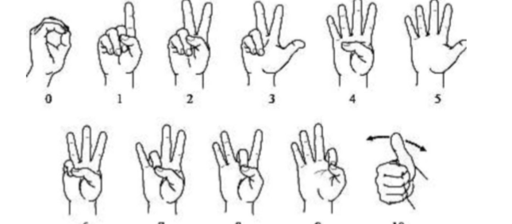
American Sign language numbers

Slide 10
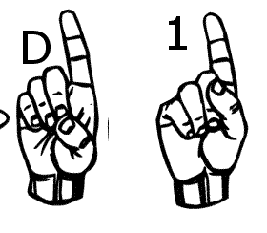
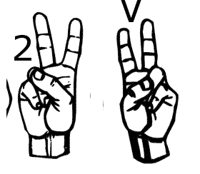
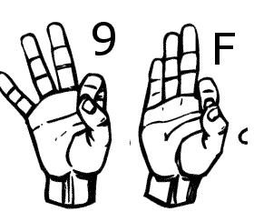
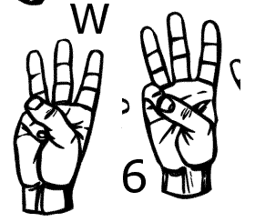
Similar Sign Gesture

Slide 11
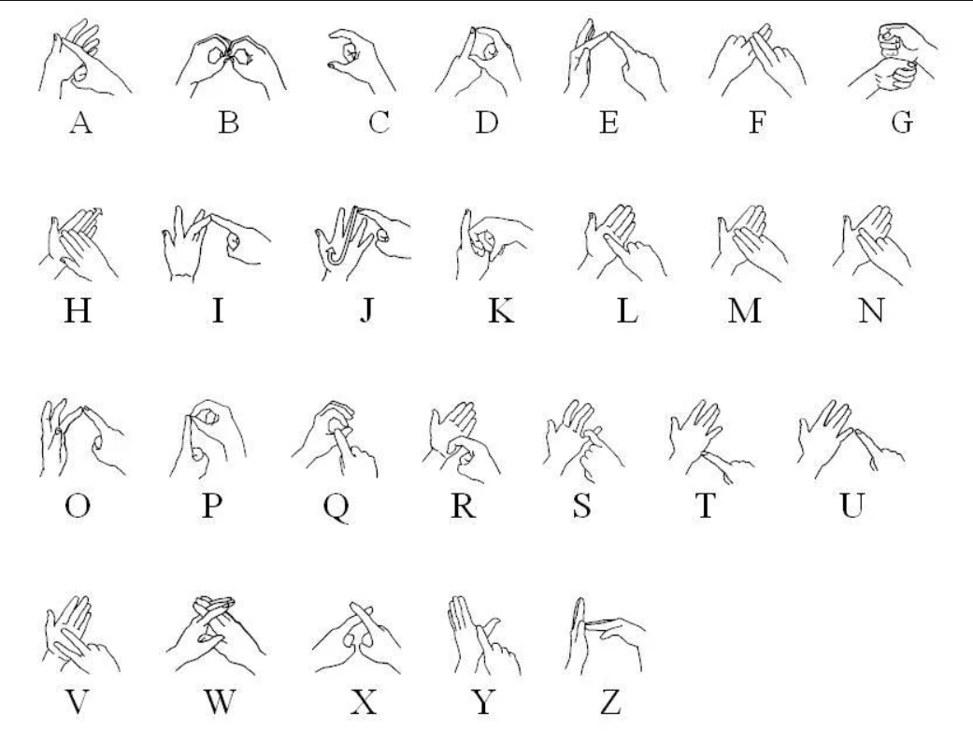
British Sign Language

Slide 12
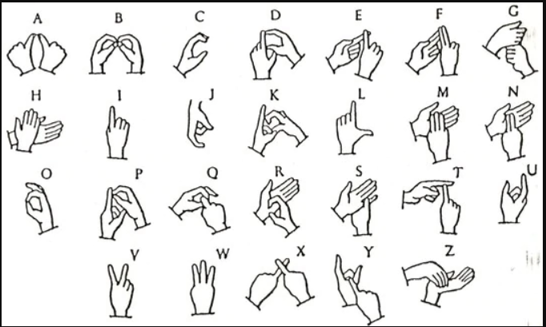
India Sign Language

Slide 13
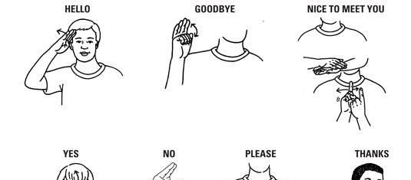
A few words in Sign language

Slide 14
Statistics of sign language use in Canada
American Sign Language | 2,485
Quebec Sign Language | 730

Slide 15
Statistics of Knowledge of Sign Languages
American Sign Language | 11,110
Quebec Sign Language | 730

Slide 16
Need for generating the dataset
There is no standard dataset available for all countries/sub continents.
In present scenario, requirement for large vocabulary dataset is in demand.
Sign language recognition systems should adopt data acquisition in any situation (not restricted to laboratory data).

Slide 17
Objectives:
Help the deaf community to increases their self-esteem and IQ level.
Deaf individual can learn by themselves
Easy learning tool

Slide 18
Dataset Description and Image property
Property | Description
Alphabets | A to Z
Numbers | 0 to 9
Color | Gray Scale
Dimensions | 50x50
Height | 50 pixels
Width | 50 pixels

Slide 19






Dataset Sample
S | A | N | D | I | P

Slide 20
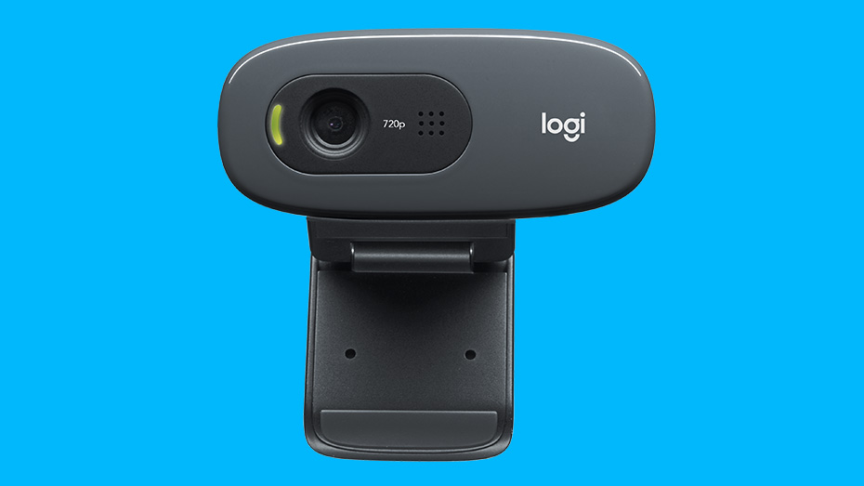
Hardware Configurations
GPU | GeForce GTX 1080 4GB
CPU | Intel(R) Core(TM) i7-8550 CPU @ 2.00GHz
Memory | DIMM 1333MHz 8GB

Slide 21
Software
Keras | 2.04
Tensor flow | 1.1.0
Python | 3.53
Operating System | Window 10
Open CV | 2.0

Slide 22

Software Used
Python
Tensor flow
Keras
OpenCV (Open Source Computer Vision Library)

Slide 23
Different software libraries
NumPy :NumPy is a package in Python used for Scientific Computing. NumPy package is used to perform different operations. The nd array (NumPy Array) is a multidimensional array used to store values of the same datatype.
Matplotlib: Matplotlib is a plotting library for the Python programming language and its numerical mathematics extension NumPy. It provides an object-oriented API for embedding plots into applications using general-purpose GUI toolkits.
Pickle: It is used for serializing and de-serializing a Python object structure. Any object in python can be pickled so that it can be saved on disk. What pickle does is that it “serializes” the object first before writing it to file. Pickling is a way to convert a python object (list, dict, etc.) into a character stream.

Slide 24
Image Processing
Image capture
Pre-processing
Segmentation detection
Description
Classification
Notes:
A Gaussian filter is a linear filter. It's usually used to blur the image or to reduce noise. ... The Gaussian filter alone will blur edges and reduce contrast. In blurring, we simply blur an image. An image looks more sharp or more detailed if we are able to perceive all the objects and their shapes correctly in it. ... This shape of an object is due to its edges.

Slide 25
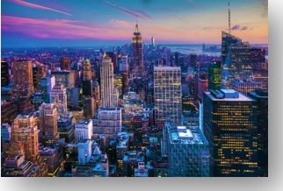
Color Image

Slide 26
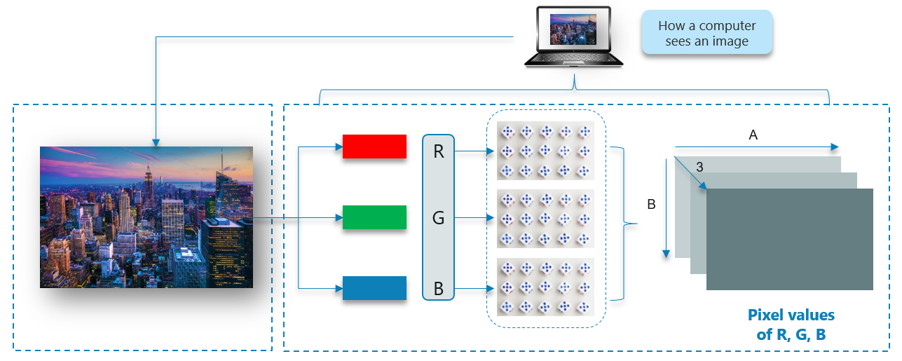
How Does A Computer Read an Image?

Slide 27
Gray Scale image

Slide 28
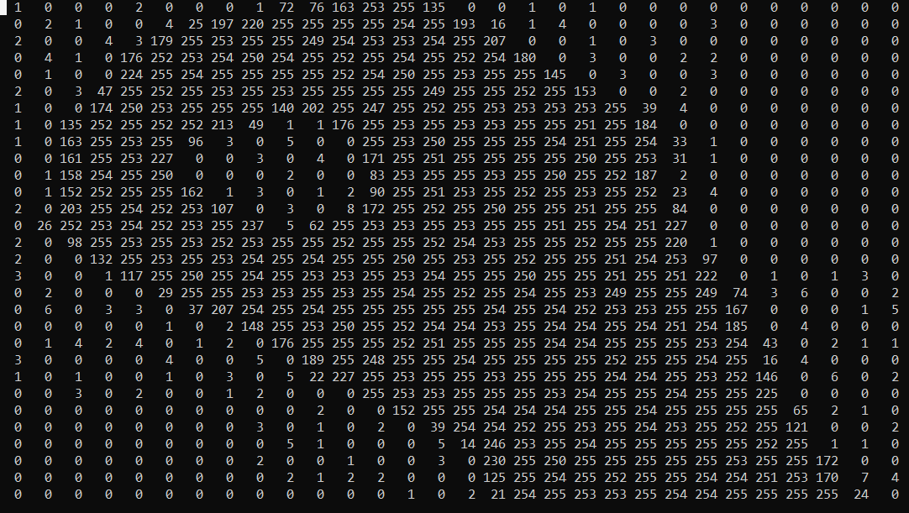
Gray scale image to 2D matrix

Slide 29
Hand posture detection steps
Loading hand gesture template contours
Capturing images from webcam
Skin detection Area
Template contours comparison with Skin Area

Slide 30
My Approach for Hand Detection
Skin Detection
Contour Comparisons

Slide 31
Machine Learning Approaches
Unsupervised Learning
Supervised Learning

Slide 32
Unsupervised Learning
The model is trained by detecting new data and recognising patterns in the data without being instructed on what they are.
The model can learn from data without supervision.
This means that there is no need for input data to be labeled.
Requires less time and resources to deploy.
The mainstream of unsupervised learning procedures are based on clustering algorithms.

Slide 33
Unsupervised Learning Models
K-means -clustering model
Self Organizing Maps (SOMs)
Principal Component Analysis (PCA) - dimensionality reduction

Slide 34
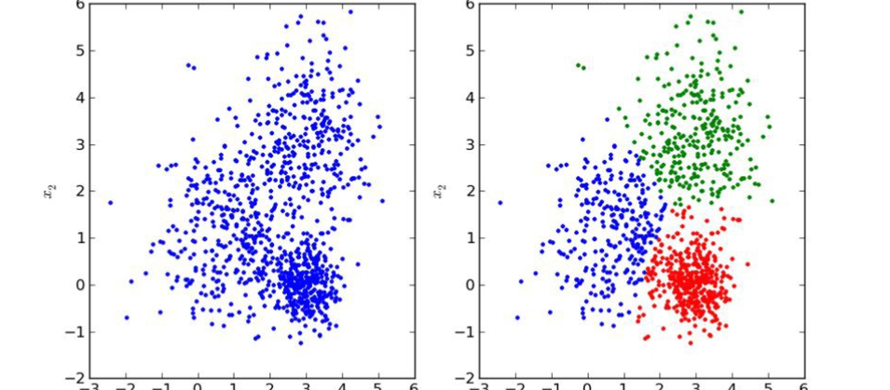
Unsupervised Learning Image

Slide 35
Supervised Learning
The supervised learning method is more commonly used.
This method needs training data with a specific format. Each instance must have assigned label.
Supervised learning problems can be further grouped into regression and classification problems.
The training process of supervised learning as follows

Slide 36
The training process of supervised learning
Training data is fed into the model with accompanying labels to produce estimates of class.
01
The output of the training data is compared to the assigned class label to evaluate the error.
02
Based on this error the learning algorithm alters model’s parameters to reduce the error and classify new data.
03

Slide 37
Structure of Machine Learning Algorithms
Dataset description
Model
Cost function
Optimization technique

Slide 38

Supervised Learning Models
Some popular examples of supervised machine learning algorithms are:
Linear regression for regression problems.
Random forest for classification and regression problems.
Support vector machines for classification problems.

Slide 39

Dataset Description and Model
Dataset: Supervised learning requires data sets with detailed properties. Each dataset holds a set of 𝑛 instances which contain a pair of input vector $x_{i}$ and output scalar $y_{i}$. Input vector where 𝑖 is the index of an instance, 𝑝, is the length of the input vector is given as:
$x_{i}^{T}=\left[x_{1},x_{2},…,x_{p}\right],$
Model : Each model has parameters represented by vector 𝜃, which are used during the training process. The simplest example of a model type is a linear model, also called linear regression. Parameters 𝜃 of this model are given as:
$θ^{T}=\left[θ_{1},θ_{2},…,θ_{p}\right]$,
Where 𝑝 is the number of parameters equal to the size of input vector $x_{i}$. Prediction ${\hat{y}}_{i}$ of the model on instance 𝑖 is computed as
${\hat{y}}_{i}$=$\sum_{j=1}^{p}{x_{ij}}θ_{j}$

Slide 40
Neural Network Architecture
Single layer feed forward network.
Multilayer Feed Forward Network

Slide 41
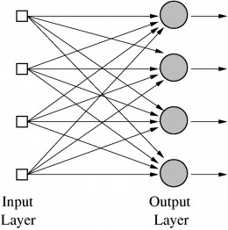
Single Layer feed forward network

Slide 42
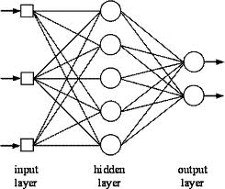
Multilayer feed forward network

Slide 43
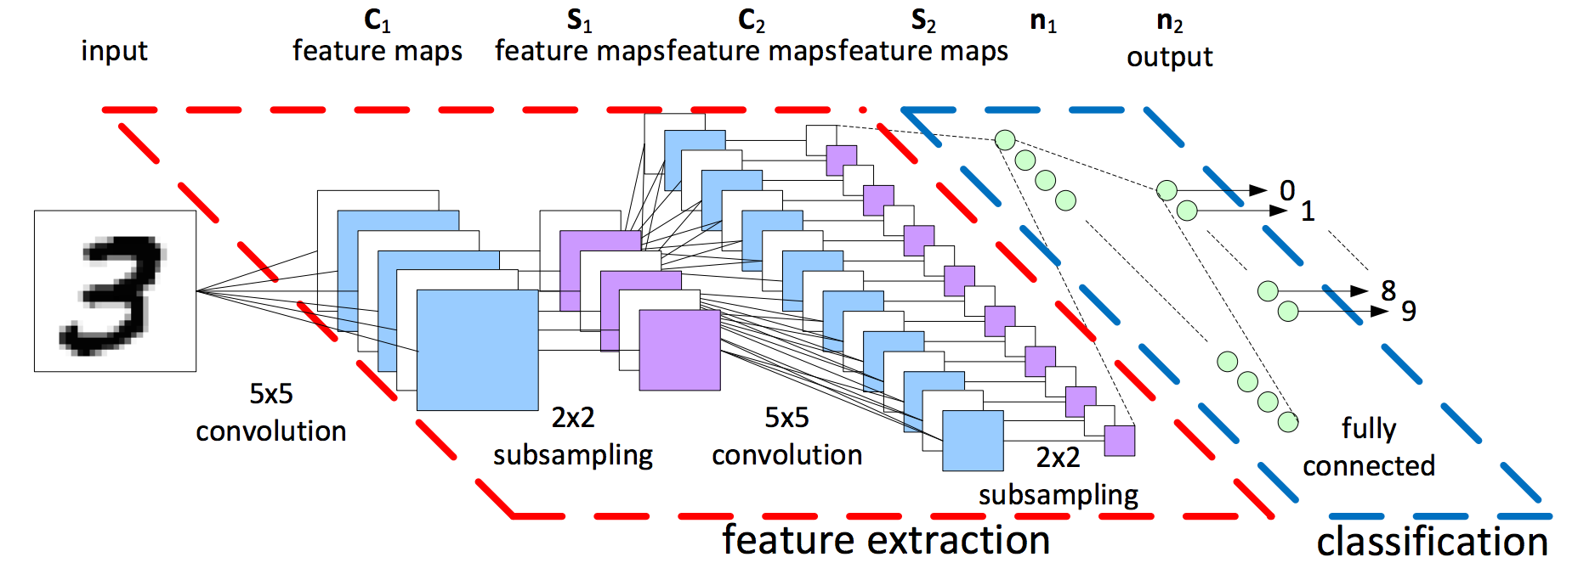
Convolutional Neural Network (CNN) Architecture

Slide 44
Model Structure
Inputs
Weights
Bias
Pooling Layer
Activation Function
Fully Connected Layer
Dropout
Flatten

Slide 45
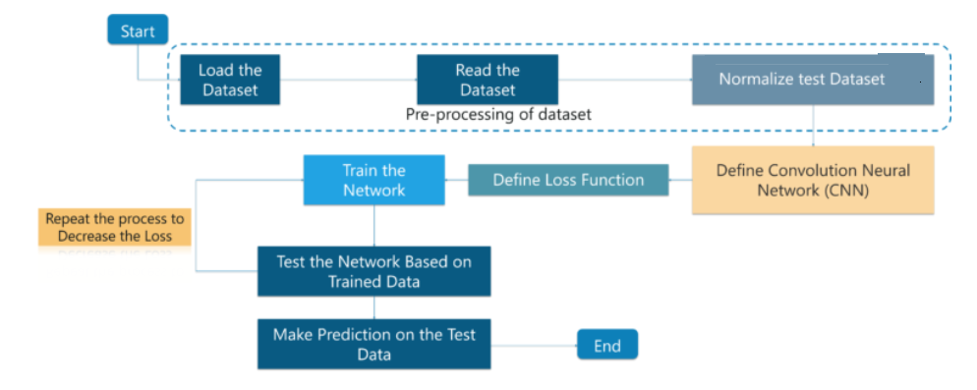
Flowchart

Slide 46
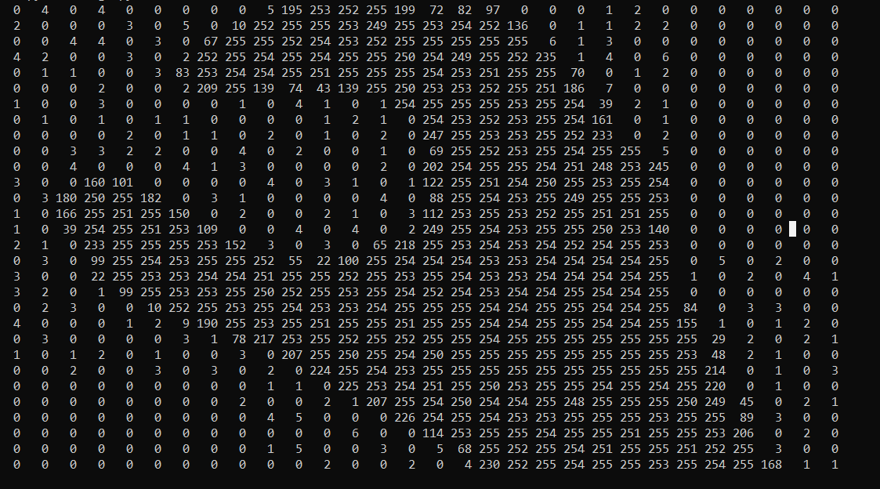
Input image to 2D matrix

Slide 47
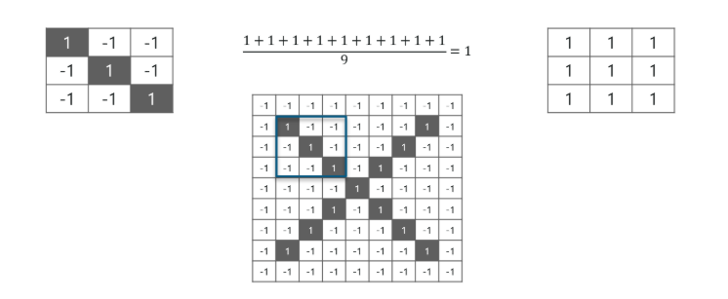
Apply Filter to input image

Slide 48
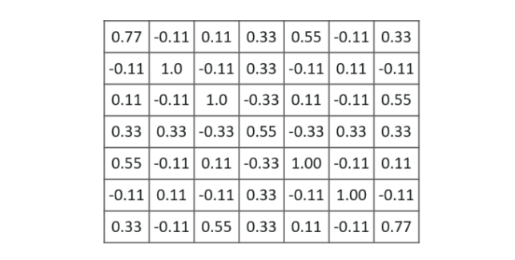
Image after application of filter

Slide 49
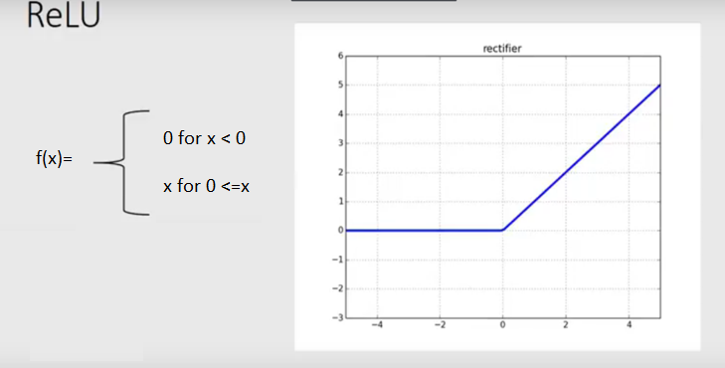
Activation Function

Slide 50
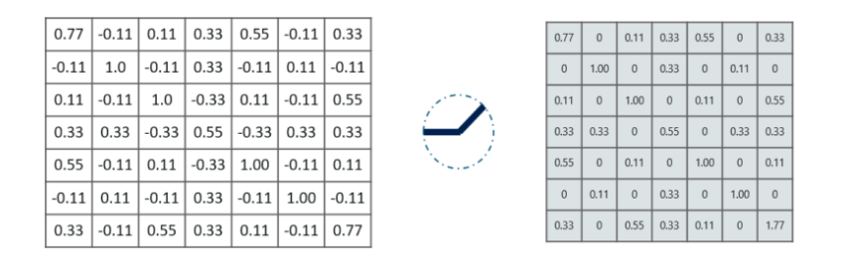
Apply RELU activation Function

Slide 51
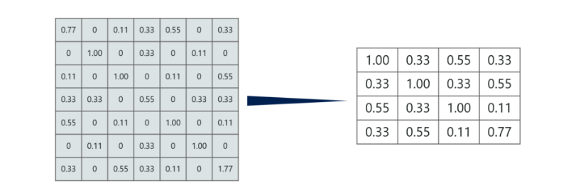
Max pooling layer

Slide 52
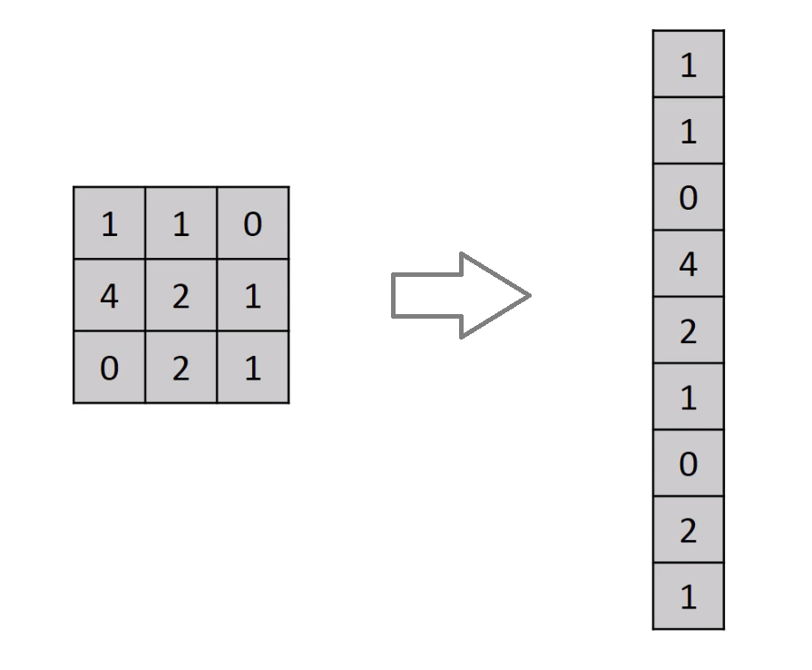
Flatten Layer

Slide 53
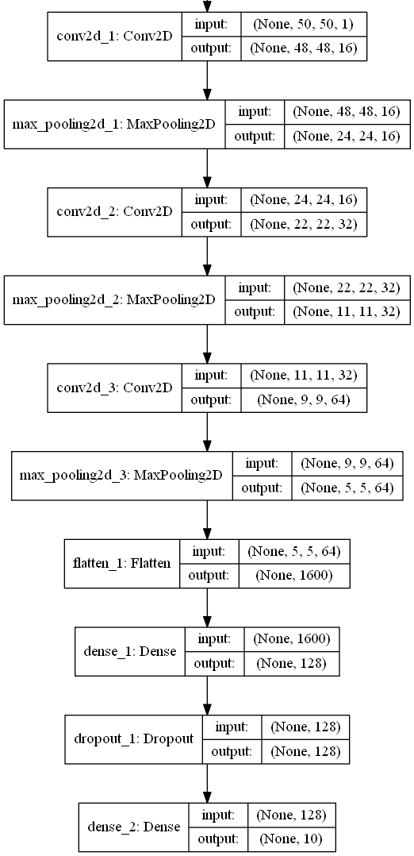
CNN Architecture

Slide 54
Approximate timing to train model
Model | Timing (Hrs)
Alphabets | 16 to 18 Hrs
Digits | 7 to 9 Hrs

Slide 55
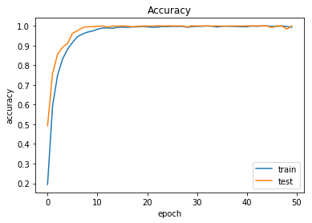
Training and Test Results on Alphabets

Slide 56
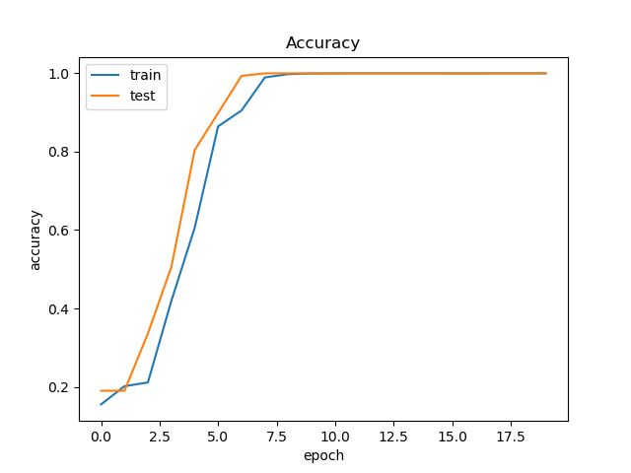
Training and Test Results for Digits

Slide 57
Confusion matrix
Precision is the proportion of the classified positive cases that were correct
Recall is the number of true positives found, i.e. the number of correct hits found.

Slide 58
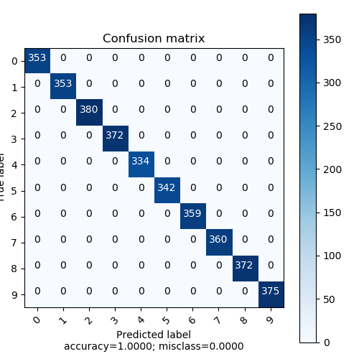
Confusion matrix for 0 to 9 digits

Slide 59
Performance on Digits
 | precision | recall | f1-score | support
0 | 1.00 | 1.00 | 1.00 | 353
1 | 1.00 | 1.00 | 1.00 | 353
2 | 1.00 | 1.00 | 1.00 | 380
3 | 1.00 | 1.00 | 1.00 | 372
4 | 1.00 | 1.00 | 1.00 | 334
5 | 1.00 | 1.00 | 1.00 | 342
6 | 1.00 | 1.00 | 1.00 | 359
7 | 1.00 | 1.00 | 1.00 | 360
8 | 1.00 | 1.00 | 1.00 | 372
9 | 1.00 | 1.00 | 1.00 | 375
weighted avg | 1.00 | 1.00 | 1.00 | 3600

Slide 60
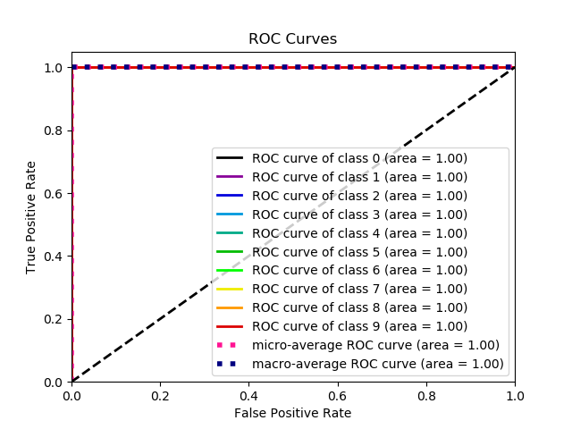

Slide 61
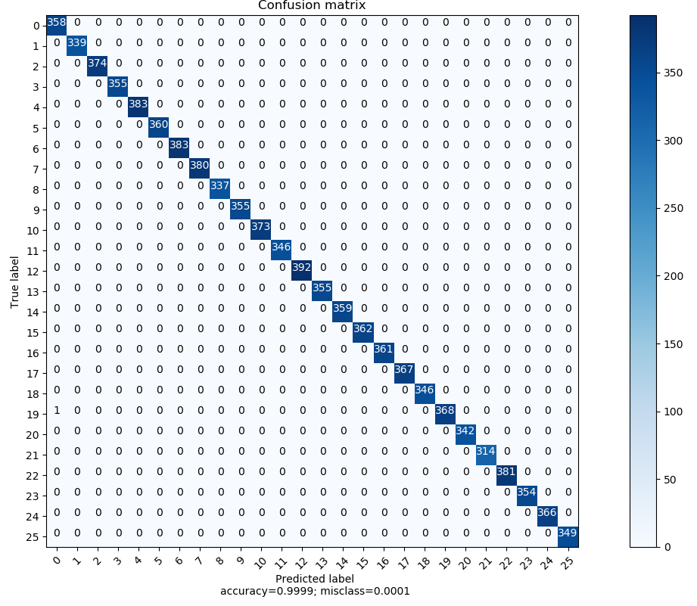
Confusion matrix for A to Z alphabets

Slide 62
Performance on Alphabets
 | precision | recall | f1-score | support
0 | 1.00 | 1.00 | 1.00 | 358
1 | 1.00 | 1.00 | 1.00 | 339
2 | 1.00 | 1.00 | 1.00 | 374
3 | 1.00 | 1.00 | 1.00 | 355
4 | 1.00 | 1.00 | 1.00 | 383
5 | 1.00 | 1.00 | 1.00 | 360
6 | 1.00 | 1.00 | 1.00 | 383
7 | 1.00 | 1.00 | 1.00 | 380
8 | 1.00 | 1.00 | 1.00 | 337
9 | 1.00 | 1.00 | 1.00 | 355
10 | 1.00 | 1.00 | 1.00 | 373
11 | 1.00 | 1.00 | 1.00 | 346
12 | 1.00 | 1.00 | 1.00 | 392
13 | 1.00 | 1.00 | 1.00 | 355
14 | 1.00 | 1.00 | 1.00 | 359
15 | 1.00 | 1.00 | 1.00 | 362
16 | 1.00 | 1.00 | 1.00 | 361
17 | 1.00 | 1.00 | 1.00 | 367
18 | 1.00 | 1.00 | 1.00 | 346
19 | 1.00 | 1.00 | 1.00 | 369
20 | 1.00 | 1.00 | 1.00 | 342
21 | 1.00 | 1.00 | 1.00 | 314
22 | 1.00 | 1.00 | 1.00 | 381
23 | 1.00 | 1.00 | 1.00 | 354
24 | 1.00 | 1.00 | 1.00 | 366
25 | 1.00 | 1.00 | 1.00 | 349
weighted avg | 1.00 | 1.00 | 1.00 | 9360

Slide 63
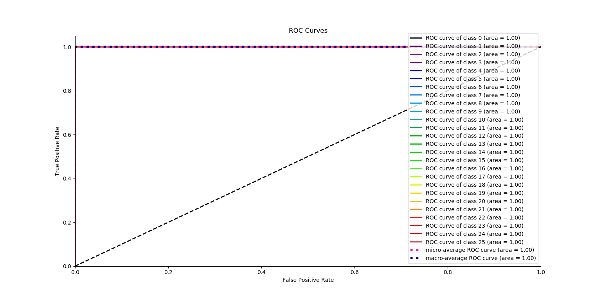

Slide 64
 | Accuracy | Misclass
Digits | 1.00 | 0.0000
Alphabets | 0.99 | 0.0001

Slide 65
Future work
Dynamic Sign Gesture Recognition
Sign Gesture Recognition from a video
Apply to 3 Dimension technique
Add more gestures in the dataset

Slide 66
Contributions
Dataset was created using Skin detection and Contour compressing algorithm.
A Gaussian filter was used to reduce noise from the image.
Thresholding technique was used to get good results for higher computation speed when compared with other methods.
Deep Learning model with Conventional Neural Network was used train the model
100% accuracy achieved for digits recognition and 99% accuracy achieved for alphabets.
Tests conducted with non-controlled form.
Non-controlled form: different lighting conditions and different backgrounds
Achieved the same accuracy.
Real-time detection and interpretation of sign language
This research will help to add sign gestures for further study.
Deaf community can benefit by using the software to learn sign language.

Slide 67
Thank you

